Slide 1
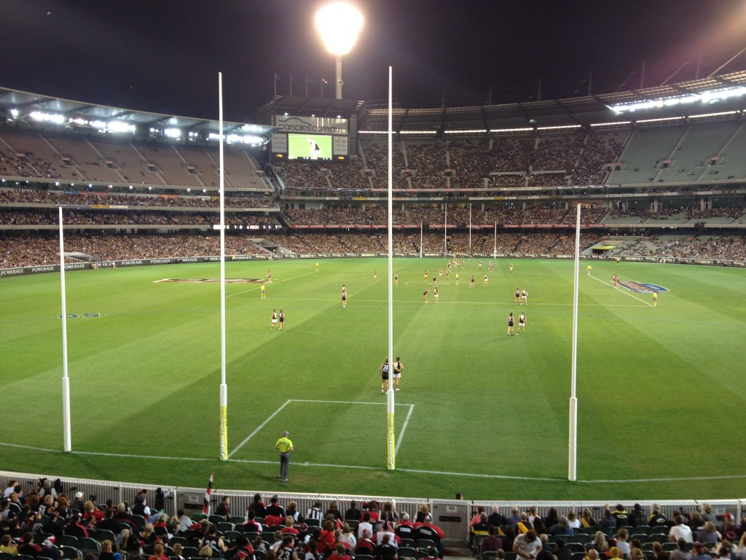
AUSTRALIAN FOOTBALL LEAGUE
IMPACT OF PLAYER POSITIONS ON GOAL KICKING PERFORMANCE
BY
ROHIT SUBRAMANIAM

Slide 2
agenda
INTRODUCTION TO THE STORY….
ROLE OF THE COACH
PLAYER POSITIONS
BUSINESS/DATA QUESTION(S)
PROJECT METHODOLOGY
DATA PROFILE
MODELLING AND EVALUATION
FINDINGS – BENEFITS FOR STAKEHOLDERS
CONCLUSIONS AND FURTHER WORK

Slide 3


INTRODUCTION TO THE STORY……
AFL is the iconic sport of Australia and the spirit of Australians.
An important sport played from March to September each year.
The game consists of 22 players per team, 3 field umpires, 4 boundary umpires and 2 goal umpires.
The game is divided into 4 quarters. Each quarter is played for 30 minutes.
Each player takes a position in the field. Aim is for each player to kick the goal.
The winning team is declared based on the number of goals kicked.

Slide 4
ROLE OF THE COACH
The coach forms the nerve centre in the team in AFL.
The coach takes the responsibility of hiring the players in the team.
The hiring is based on the skills of the player to kick the goals from different positions.
Player positioning is very important for kicking goals.
The next slide will give you all an understanding of different positions related to goal kicking……..

Slide 5
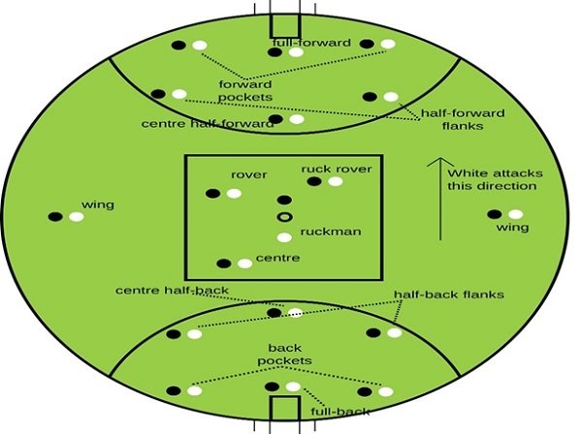
PLAYER POSITIONS

Slide 6
BUSINESS QUESTION
Does player position influence goal kicking?
DATA QUESTION
Which statistical models accurately reflect the factors that impact goal kicking performance?
Stakeholder(S)
Australian Football League, AFL clubs and coaches, Sports Analyst and Champion Data.

Slide 7
PROJECT METHODOLOGY
Stakeholders
Merged both datasets and imported
Data Analysis
Key Variable Selections
Modelling and Evaluation
Conclusions

Slide 8
Data PROFILE
Both datasets (1999-2019) consist of 12742 and 840 entries respectively.
Numerical and categorical features involved.
Only the variables goal assists and disposals contained null values.
Created binary variables (goal kicker and forward player) on the basis of a player kicking more than 2 goals.
Performed exploratory data analysis.
Key variables selected based on correlations and to improve model performance.

Slide 9
MODELLING AND EVALUATION
PERFORMANCE OF LINEAR REGRESSION MODELS
Regressed based on parameters that have the strongest positive and weakest negative correlations.

Slide 10
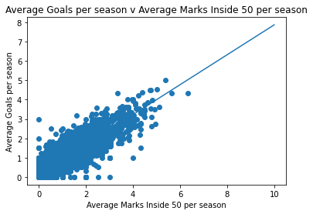
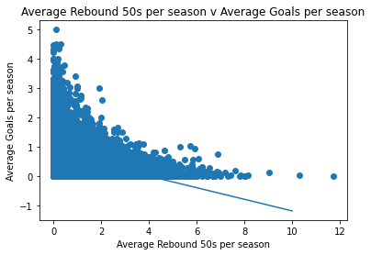
LINEAR REGRESSION RESULTS
Figure 1: Linear regression between Average Goals per season and Average Marks Inside 50s per season
Figure 2: Linear regression between Average Goals per season and Average Rebound 50s per season

Slide 11
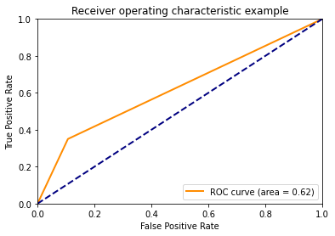
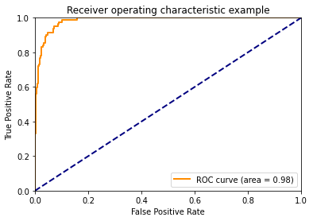
Classification models-Performance of LOGISTIC REGRESSION
Oversampled the data prior to applying all classification models as it was imbalanced.
Chose parameters that would improve model performance.
Figure 3: Receiver Operating Characteristics for test data set (goal kicker and forward player)
Figure 4: Receiver Operating Characteristics for test data set (additional variables)

Slide 12
Score and ACCURACY OF LOGISTIC REGRESSION
Variables included | Score | Accuracy
Forward player and goal kicker | 0.96 | 0.9656 (training data set) 0.9608 (test data set)
Forward Player, Marks Inside 50, Contested Marks, Disposals, Goal Assists and Goal Kicker | 0.98 | 0.9805 (training data set) 0.9820 (test data set)
Table 1: Performance of logistic regression

Slide 13
PERFORMANCE OF OTHER CLASSIFICATION MODELS
Applied other classification methods such as:
Support Vector Machine
Naïve Bayesian Classifier
Decision Tree
Random Forest
Bagging – highest accuracy/precision/recall value.
Adaptive Boosting

Slide 14
FINDINGS - BENEFITS FOR STAKEHOLDERS
AFL club and coaches–recruit players skilled with
1.) Marks Inside 50 metres
2.) Contested Marks
3.) Goal Assists
4.) Disposals
Champion data and Sports Analyst – continue to see if the above metrics will continue to influence goal kicking performance in the next few years.

Slide 15
CONCLUSIONS
The ability to kick goals is influenced by the marks taken in forward area along with disposals, contested marks and goal assists.
Logistic and Bagging classifications were the most accurate model to predict goal kickers and illustrated player position’s impact on goal kicking performance.
FURTHER WORK
Impact of player positions on other key statistics such as clearances, uncontested possessions and so on.
Predicting and minimising potential injuries for forward players.

